Slide 1
The Most amazing thing about Android yet

Slide 2
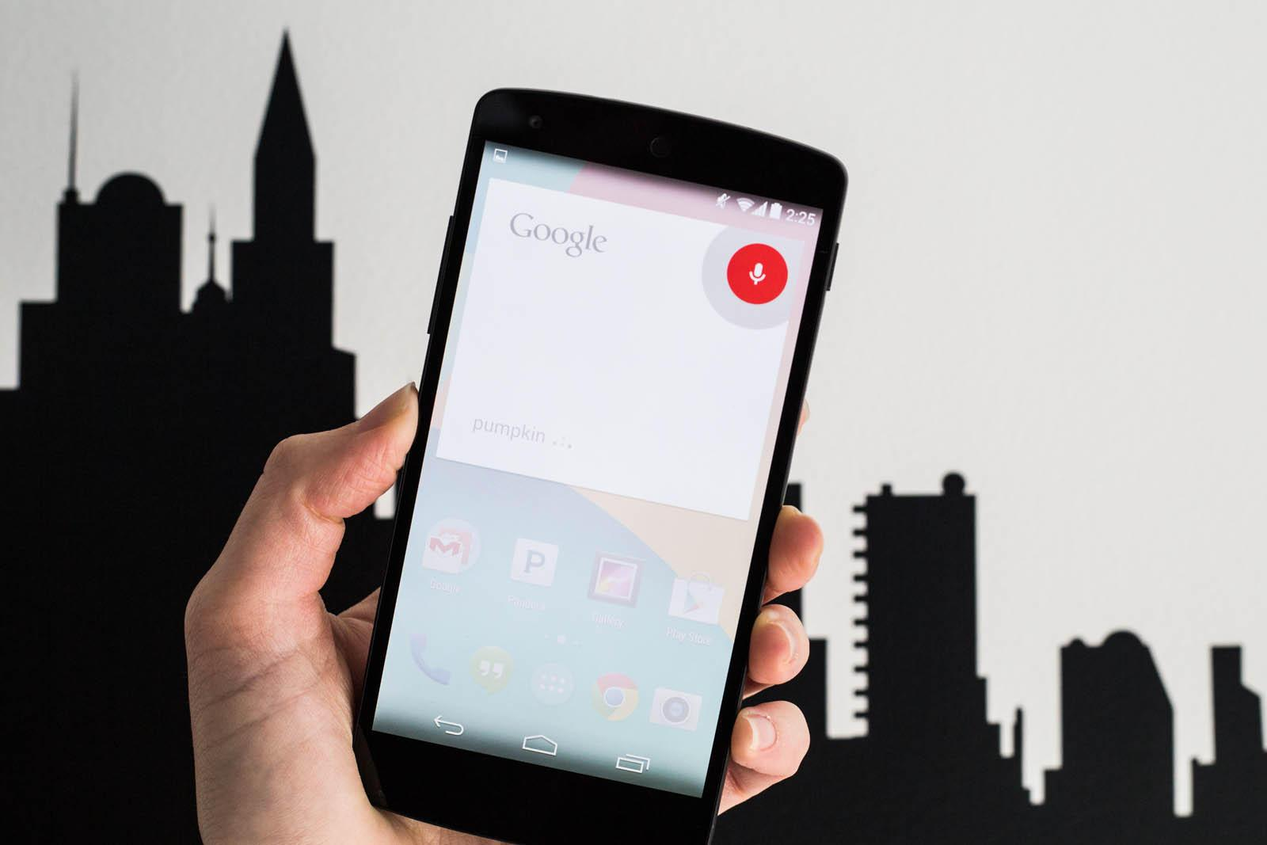
Google Now

Slide 3
How many People speak Urdu ?

Slide 4
104.00 million urdu

Slide 5

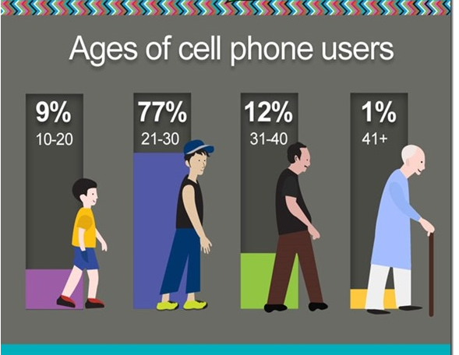

Slide 6


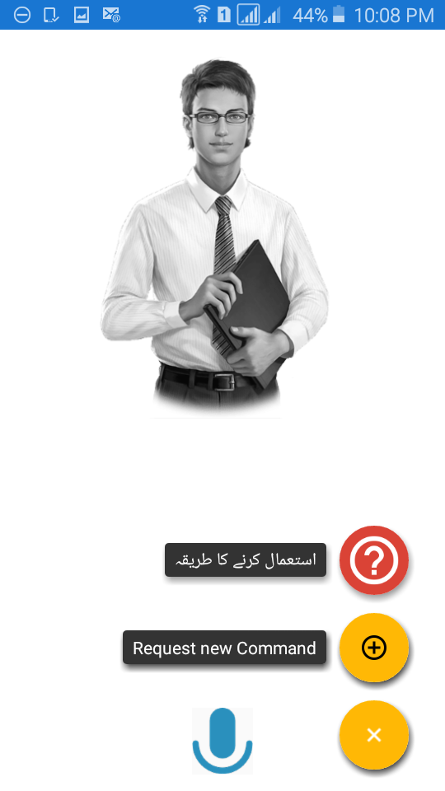
Introducing OK Ameer
Unexpected Pakistan first android assistant
Emotional
Simple

Slide 7
What You can Do With it?
Handle daily simple task eg
Device Control e.g. “flash light on karo”
Communication e.g. “message liko ”
Social media e.g. “what’s app send karo”
Set Remanders e.g. “alram set karo(Beta)”
Entertainment e.g. “”Youtube say gana lagao”
And so on...

Slide 8
Future work
Add more commands e.g. “ajj ka mausam kasia rhay ga”
Support for home automation e.g. “light band karo”

Slide 9
Damo

